Slide 1
UNSUPERVISED MACHINE LEARNING PROJECT
Student Behavior Clustering & Segment Interpretation
Uncovering actionable behavioral archetypes from 14,003 academic performance records using K-Means clustering.
PRESENTER
COLLEGE
UNIVERSITY
Nihar Minj (ERP: 6605332)
Rungta College of Engineering And Technology
CSVTU
Dataset Size
Key Indicators
Optimal Partitioning
14,003 Students
Study Hours, Attendance, Exam Score
K = 4 Clusters

Slide 2



EXECUTIVE SUMMARY
Key Analytical Findings
Standardized Pipeline
Distinct Clusters
Targeted Support
StandardScaler normalization prevented feature dominance during distance calculation.
Elbow curvature evaluation confirmed four primary behavioral student personas.
Enables custom academic interventions based on behavioral group profile.

Slide 3
DATA ARCHITECTURE
Feature Selection & Normalization
Selected Modeling Features
Three core quantitative indicators drive student behavioral segmentation:
StandardScaler Transformation
Standardizes variables to zero mean and unit variance.
Study Hours: Weekly dedicated independent study duration
z = (x - μ) / σ
Attendance: Percentage of total lectures attended
Eliminates scale bias between attendance percentages and weekly study hours.
Exam Score: Academic performance measurement metric

Slide 4


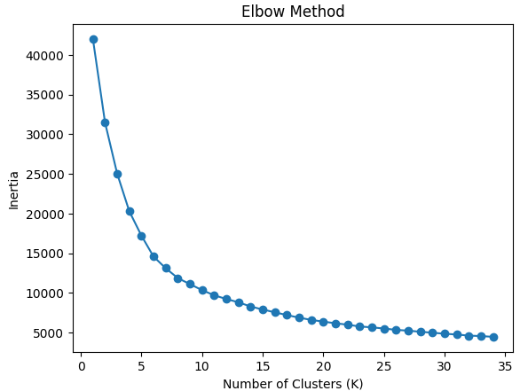
HYPERPARAMETER TUNING
Elbow Curve & Population Partitioning
Optimal K = 4 Selection
Inertia inflection point stabilizes at K=4, minimizing within-cluster variance.
Balanced Cluster Sizes
Cluster 0: 3,675 students (26.2%)
Cluster 1: 3,604 students (25.7%)
Cluster 2: 3,389 students (24.2%)
Cluster 3: 3,335 students (23.8%)

Slide 5


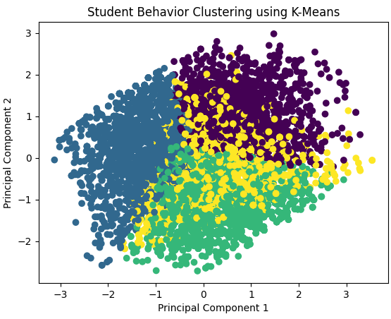
DIMENSIONALITY REDUCTION
PCA 2D Mapping of Student Clusters
Principal Component 1
Captures primary variance driven by engagement metrics (Study Hours & Attendance).
Principal Component 2
Represents academic performance output variance across exam score distributions.
Clear Boundaries
Distinct color-coded cluster groupings demonstrate high spatial separability.

Slide 6
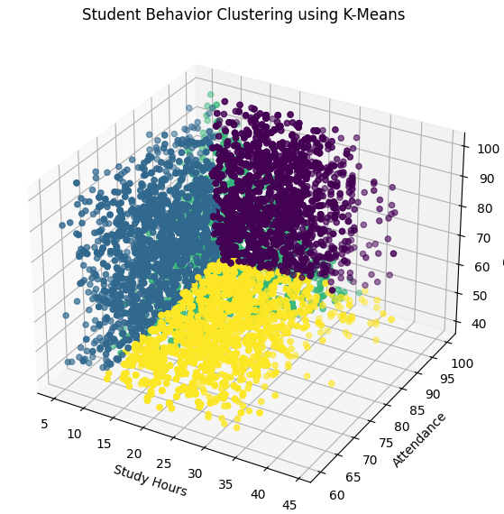
SPATIAL FEATURE ANALYSIS
3D Feature Space Clustering Visualization
Study Hours Axis
Ranges from 5 to 45 hours, delineating low vs. high independent effort.
Attendance Axis
Spans 60% to 100% lecture attendance rates across all student cohorts.
Exam Score Vertical
Highlights the strong correlation between combined engagement and final grades.

Slide 7
CLUSTER PERSONA 0 (N = 3,675)
High-Performing Scholars
Top Performers (26.2%)
STUDY HOURS
ATTENDANCE
EXAM SCORE
High
High
High
Consistent daily study habits.
Regular classroom participation.
Superior final test outcomes.

Slide 8
CLUSTER PERSONA 1 (N = 3,604)
Moderate Consistent Students
Steady Learners (25.7%)
STUDY HOURS
ATTENDANCE
EXAM SCORE
Moderate
Moderate
Average
Balanced study routines.
Consistent attendance records.
Satisfactory passing grades.

Slide 9
CLUSTER PERSONA 2 (N = 3,389)
Strategic / Efficiency Seekers
High Efficiency (24.2%)
STUDY HOURS
ATTENDANCE
EXAM SCORE
Low / Mod
Moderate
High
Minimal independent study.
Selective class participation.
Strong exam performance.

Slide 10
CLUSTER PERSONA 3 (N = 3,335)
At-Risk / Disengaged Learners
Intervention Needed (23.8%)
STUDY HOURS
ATTENDANCE
EXAM SCORE
Low
Low
Low
Inadequate preparation effort.
Frequent absent record.
Poor test performance.

Slide 11
COMPARATIVE ANALYSIS
Cluster Profile Comparison Matrix
Cluster | Student Count | Study Hours | Attendance | Exam Score | Primary Profile
Cluster 0 | 3,675 (26.2%) | High | High | High | Dedicated High Achievers
Cluster 1 | 3,604 (25.7%) | Moderate | Moderate | Average | Steady Core Performers
Cluster 2 | 3,389 (24.2%) | Low / Moderate | Moderate | High | Strategic Fast Learners
Cluster 3 | 3,335 (23.8%) | Low | Low | Low | At-Risk Disengaged Students

Slide 12
CONCLUSION & DISCUSSION
Data-Driven Academic Excellence
Questions & Discussion on Behavioral Clustering Models

